Slide 1
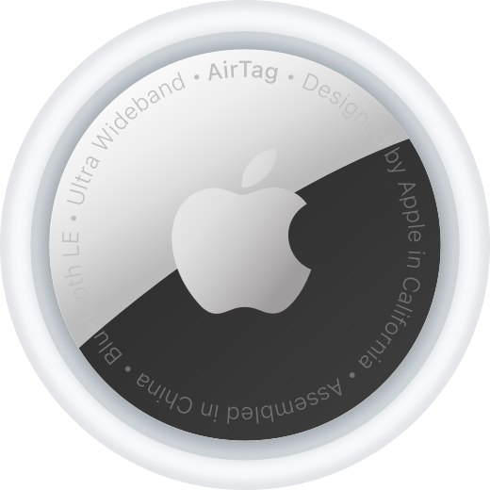
Twitter Sentiment Analysis - AirTag
Abby Liu

Slide 2
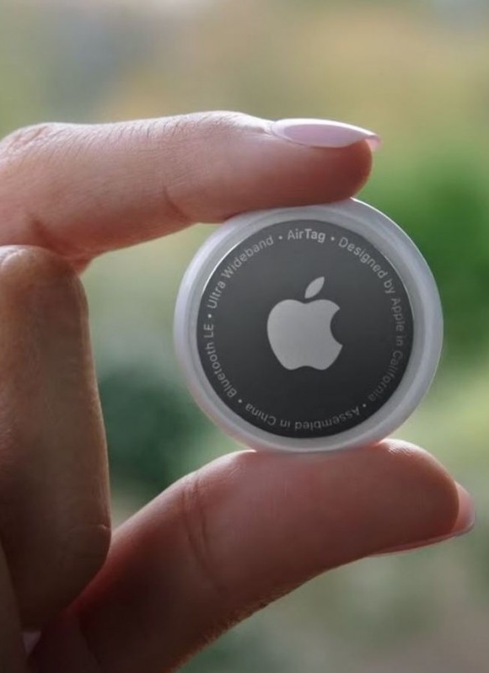
Questions:
What do customers think of Apple’s new product AirTag?
How can we use these comments/feedback to improve this product and marketing strategies as well?

Slide 3
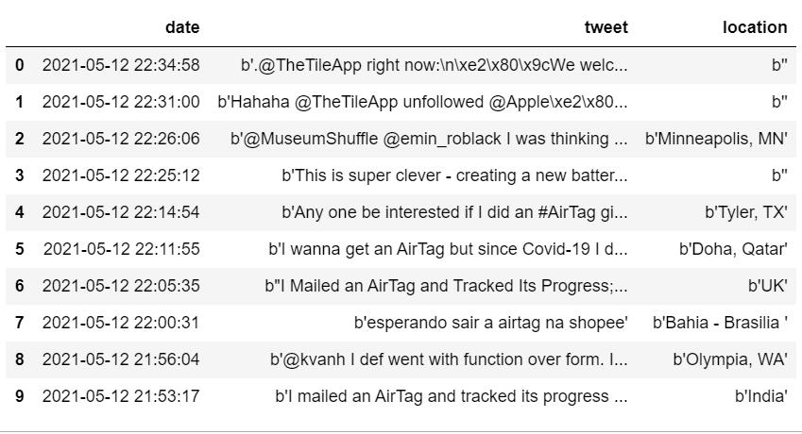
Data Pulled from Twitter API

Slide 4
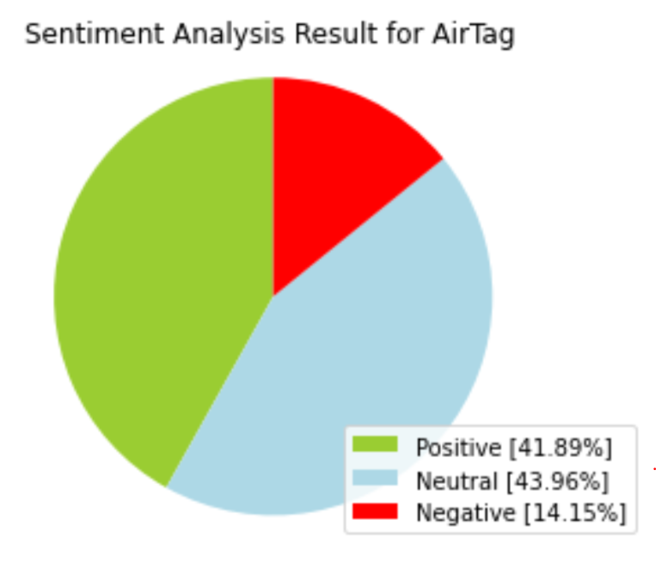
Sentiment Analysis

Slide 5
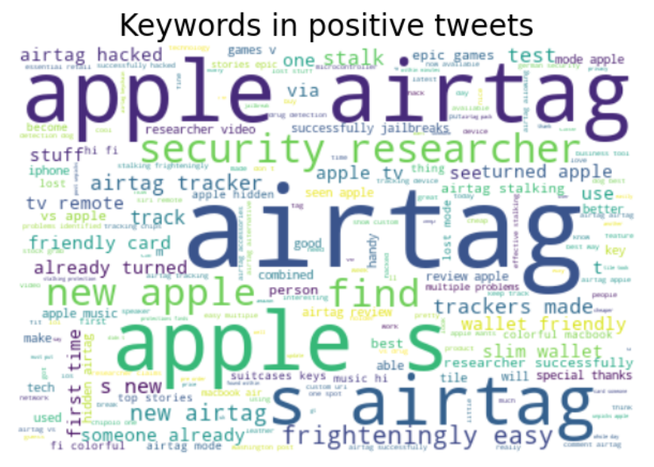
Keywords in Positive Tweets

Slide 6
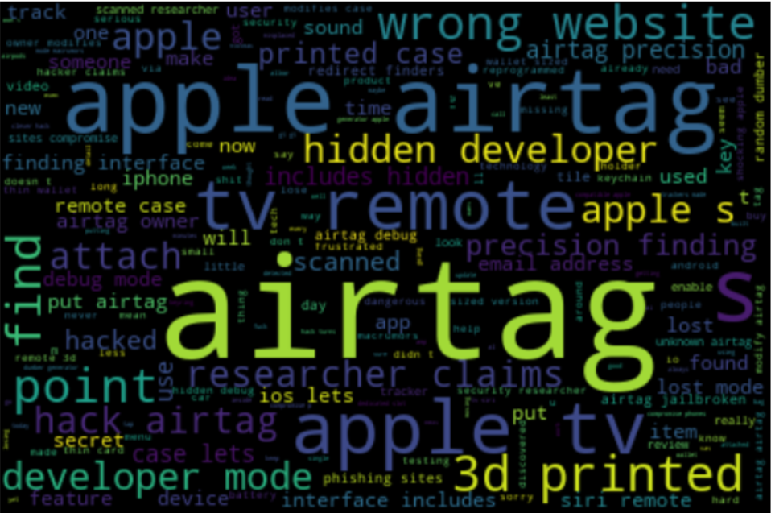
Keywords in Negative Tweets

Slide 7
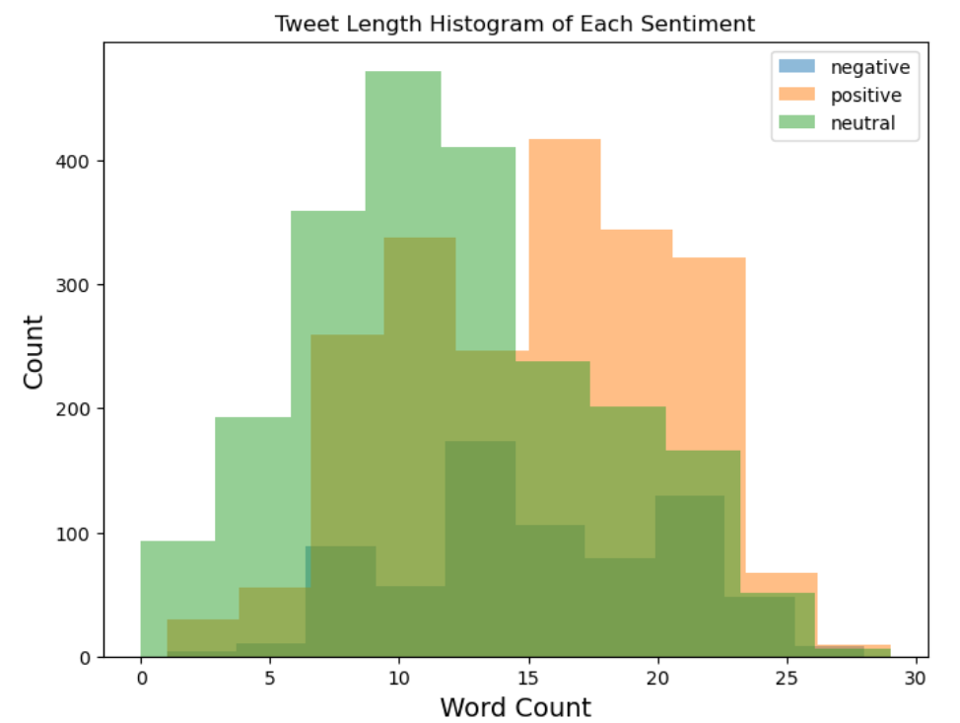
Tweet Length by Sentiment

Slide 8
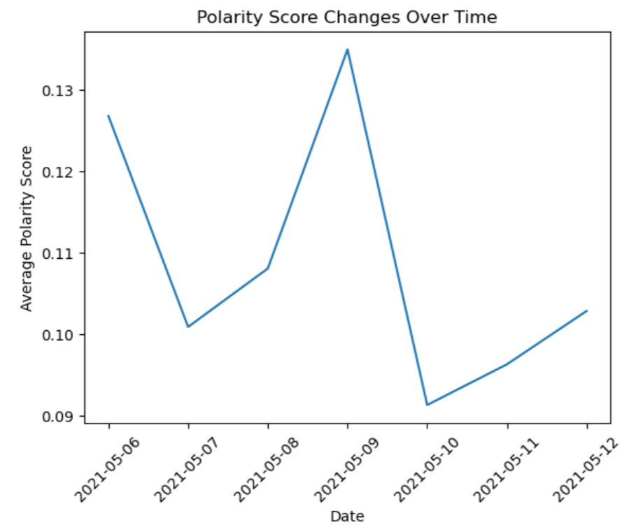
Emotion Trends

Slide 9
Preprocessing and Training
Tokenization was done to split sentences into tokens.
Stop words were removed to give more focus to the important information.
Lemmatization was done to convert words to their meaningful base forms.
The dataset was vectorized by using the CountVectorizer, which turned the text into numerical data.

Slide 10

Model Selection
Model | Parameter | Accuracy | Precision | Recall | F1
MultinomialNB | alpha=0.1 | 0.86 | 0.501 | 0.696 | 0.582
LogisticRegression | C=10.5 | 0.92 | 0.838 | 0.565 | 0.673

Slide 11
Conclusion
Based on my findings, by the second week after AirTag was released, the general perception of AirTag was really good. Only 14.15% of tweets that people posted about it were negative.

Slide 12
Recommendation #1
By looking at the most common keywords used in those negative tweets, we discovered that people who complained about AirTag were mostly worried about its security, which suggested that it could be easy to hack and could be used for stalking.
To improve its product, Apple should focus on fixing the security problem and make AirTag safer to use. On the other hand, keywords like “wallet friendly” and “find” were mentioned a lot in the positive tweets, so these advantages can be emphasized in Apple’s marketing materials to get more people interested in the product.

Slide 13
Recommendation #2
Besides Apple Inc, other businesses can also use my sentiment analysis as a guide to monitor the performance of their own products; also, the negative tweet detector can not only be used to detect negative tweets, but it can also be used to detect negative comments, negative emails, or negative customer reviews. By collecting the negative reviews and analyzing them, companies can better understand their products and work on improvement more effectively.

Slide 14

Thank You!

